Slide 1

PDLib
Process Development Library for
Machine Software Development framework
HDD Suspension Business Division
Feb 6, 2017

Slide 2
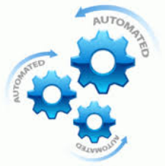
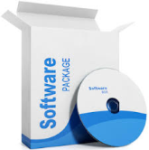

PDLib vs None framework
What is PD Lib?
PDLib is the name of software library and framework for machine software development. It create from C# .Net language.
PDLib can software engineer to reduce software development time and reduce problem (bug) in the application software. This is because of PDLib will provide mandatory part for machine software development Ex. component structure, machine sequence structure & editor, handling user interface (GUI) with data, hardware interface library pattern.
None framework
PDLib
C#
Machine Application
C#
PDLib
Machine Application
Implement on C# base only
Implement on
C# base + PDLib
Structure
App Structure
Structure
Etc.
Application Base
Sequencer
HW Library
App Structure
Machine SW Base
App GUI Design
Sequencer
GUI Handler
GUI Handler
SW Pattern
Application Base
App GUI Design
App State Machine
Included in PDLib
SW Pattern
App State Machine
HW Library
Independent Design
Base on developer Skill
PdLib will eliminate
Machine SW Base Complexity
Application Base
Still Independent Design
Base on developer Skill
Etc.
Software Developer need focus on everything.
- Slower Development Time
Produce more bug
None Structure (structure base on each developer or vender)
None Pattern (pattern base on each developer or vender)
Hard to work as team cause by no framework.
Hard debug for other developer cause by no framework.
Software Developer need focus on application area only.
- Faster Development time
Reduce bug
Standard Structure
Standard Pattern
Easy to work as team cause by standard framework.
Easy debug for other developer cause by standard framework.

Slide 3
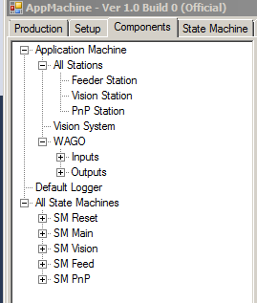
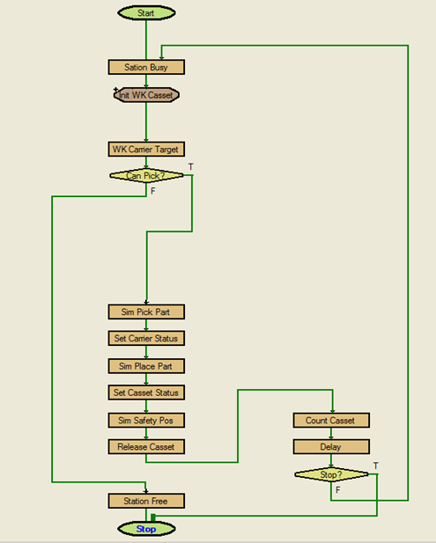
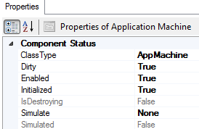

What’s is built-in on PDLib?
Structure
Sequencer
PdLib already provide overall software structure with “Tree” structure and naming of each component. It also come with “Property management” of each software component.
With this structure, It is very easy too manage each software component.
It easy to add, delete, modify and retrieve each software object on each software classes.
PdLib provided machine sequencer which most complex part in the machine software base. It’s come with easy editor tool by use
graphic flow chart for create and edit machine sequence (machine state)
Developer will reduce time and bug for create machine sequence.
This is use full tool because we can create and modify machine state
with small coding. (All state machine sequence will saved in the XML file)
Root
Comp1
Comp1-1
Comp1-2
Property Management
Comp1-2-1
Comp1-2-N
PdLib
component with
tree structure
and browser Tools
Comp2
State Machine Editor
with graphical flow chart
and need small coding
CompN
GUI Handler
PdLib provided many GUI that easily to bind and handle with data. It reduce complexity a lot about data display and update
String
Built-in many GUI control
and support multiple data type
With easy binding code
Double
Auto 2 ways update
Integer
Boolean
Example
Etc.
Easy code for
binding GUI and Data

Slide 4





What’s is built-in on PDLib? (Cont.)
Software Pattern
Hardware Control Library
PDLib has many base classes component which allow you to create your new component
which inherited from those base class. Those base classes come with software pattern.
So we can follow those pattern which help us to fast develop and reduce bug.
PDLib comes with initial some hardware control library.
In your machine application use the same hardware then your can use it without modify any line of code. We call these library are “Plug in”
PDLib also allow you to create new library for support new hardware and store it in plug in repository. So you can re-use in on next time by no need coding again.
Example
Base Class
Vision System
Base
Motion System
Base
IO System
Base
Other Base
Akribis
Motion
Example
Plugin
NI
Vision
IAI
Motion
Cognex
Vision
IAI
Motion
Advantech
IO
Yamaha
Motion
Advantech
IO
Yamaha
Motion
Cognex
Vision
NI
Vision
WAGO
IO
Akribis
Motion
WAGO
IO
Implement our class with pattern from PDLib base
Etc
Reuse existing
plugin library
without any coding
PDLib provided many utility function call that help us to easy develop machine application. With those utility it will reduce complexity in machine application code.
Example Very Useful Utility
- Easy get any software object in any place of code with simple coding.
- Easy register any property data change event to service any changed with simple coding.
- Easy put log by simple coding

Slide 5
We still need some improvement on Application Layer
C#
PDLib
Machine Application
Implement on
C# base + PDLib
Structure
Etc.
We need to improve this area for
More fast develop
More reduce bug
More standard pattern
Sequencer
HW Library
App Structure
GUI Handler
SW Pattern
Application Base
App GUI Design
Included in PDLib
App State Machine
Application Base
Still Independent Design
Base on developer Skill
Due to PDLib provided machine software base library and platform. However there are some development tasks that machine software
developer need to workout ( Structure, GUI Design and handle, State machine ) and quality of output based on developer skill and experience.
Follow above reason, project may be fail, delay or poor software quality because of skill of developer is not good enough.
So we need to improve this area to get more chance to success on machine software development project.
We will also need to create standard structure, GUI pattern, state machine pattern for scope developer to follow the pattern.
With this idea, every machine application will come out with similar pattern. It result to faster development time, easy for other developer
to take a look and study and much more better for reduce bug.

Slide 6
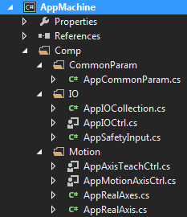
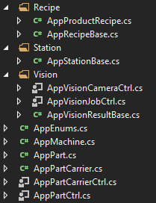
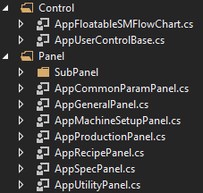

PDLib Application Layer Standard Structure
Root Component
XML Root Layer. Each component on this layer will serialize on separate XML
We can transfer to another machine easily by this structure.
Default Logger
Common
Parameter
IO
Collection
State Machine
Collection
Recipes
Collection
Machine
Root
Parameter A
Inputs
SM Main
Recipe A
Stations Collection
Define machine
function call of
each station
Ex.
-Move motion
-Do Vision
-Etc
Sub Par A
Input A
SM Reset
Recipe B
Station A
Sub Par B
Input B
State A
Station B
State B
Recipe N
Sub Par N
Input N
Define recipe and its
Property base on
product specific
Station N
Parameter A
Outputs
State N
Vision System A
Define machine common
parameter for support
Machine sequence
Ex.
- Motion Speed
Sub Par A
Output A
Define State machine
SM Main and SM Reset
are mandatory state machine
Camera A
Sub Par B
Output B
Vision Job A
Job Result
Sub Par N
Output N
Define I/O of the machine
Inputs will collect all input bit.
Outputs will collect all output bit
Vision System Structure
with N System and N Camera
With N Vision Job
Vision Job N
Job Result
Camera N
Vision System N
Motion System A
Motion System Structure
with N System and N Axis
Motion Axes
Axis A
Axis B
Axis N
These standard structure already provide in application project template
Motion System N

Slide 7
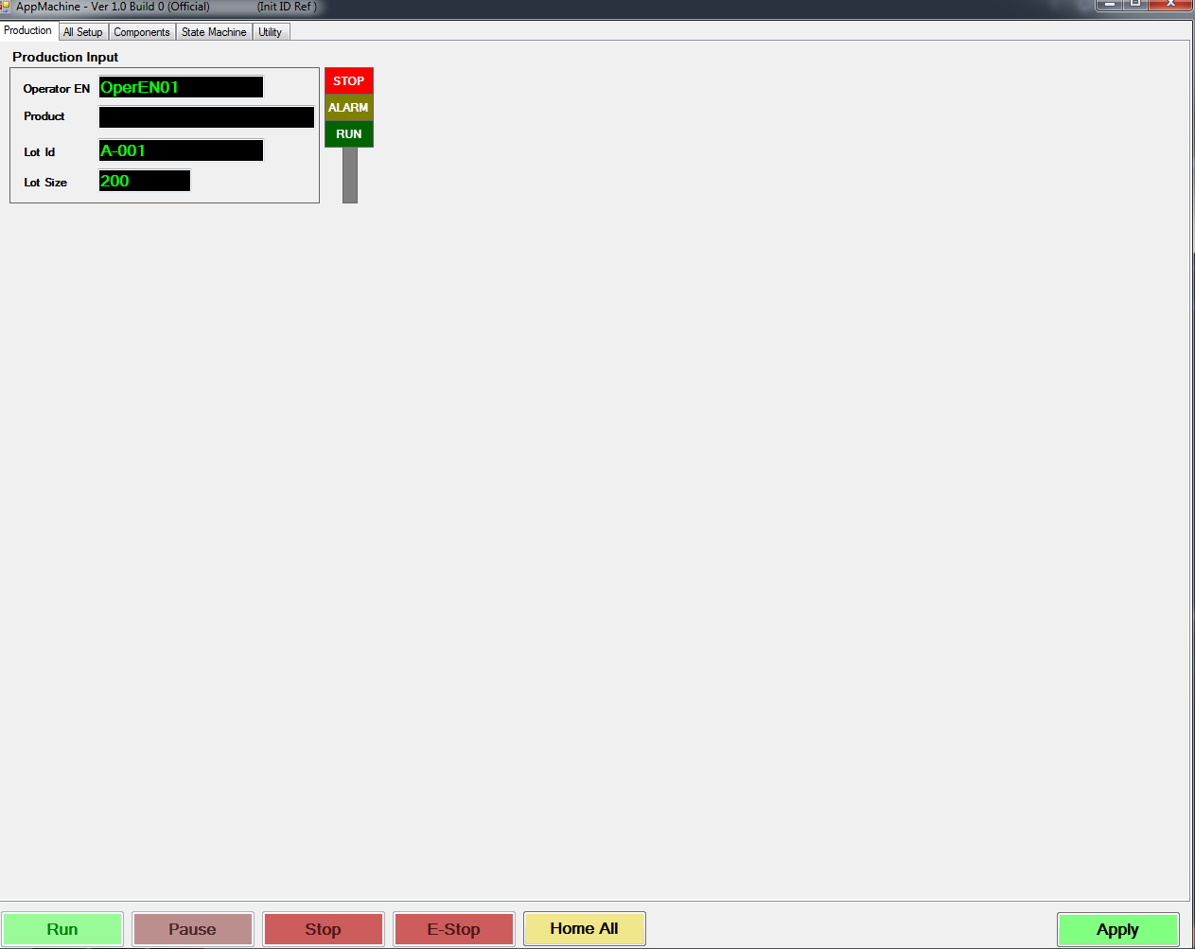
PDLib Application Layer GUI Pattern
Main GUI & Production Panel
Provided standard main panel layout
Production Panel
Production Panel pre-design
basic Information with binding code.
Production Panel free area to design
base on application requirement
Main GUI already provide
standard control button include
mechanism source code
to control machine software

Slide 8
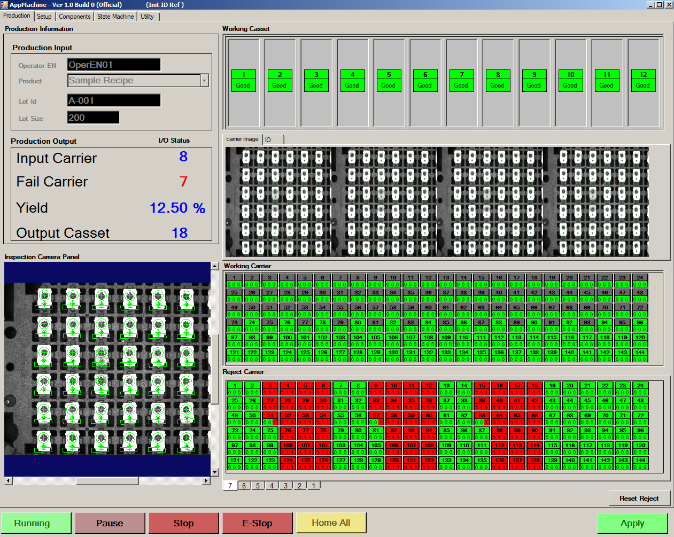
PDLib Application Layer GUI Pattern
Production Panel
Production Panel
Example production panel
complete design on
HTO-Welder
Auto Loader Machine

Slide 9
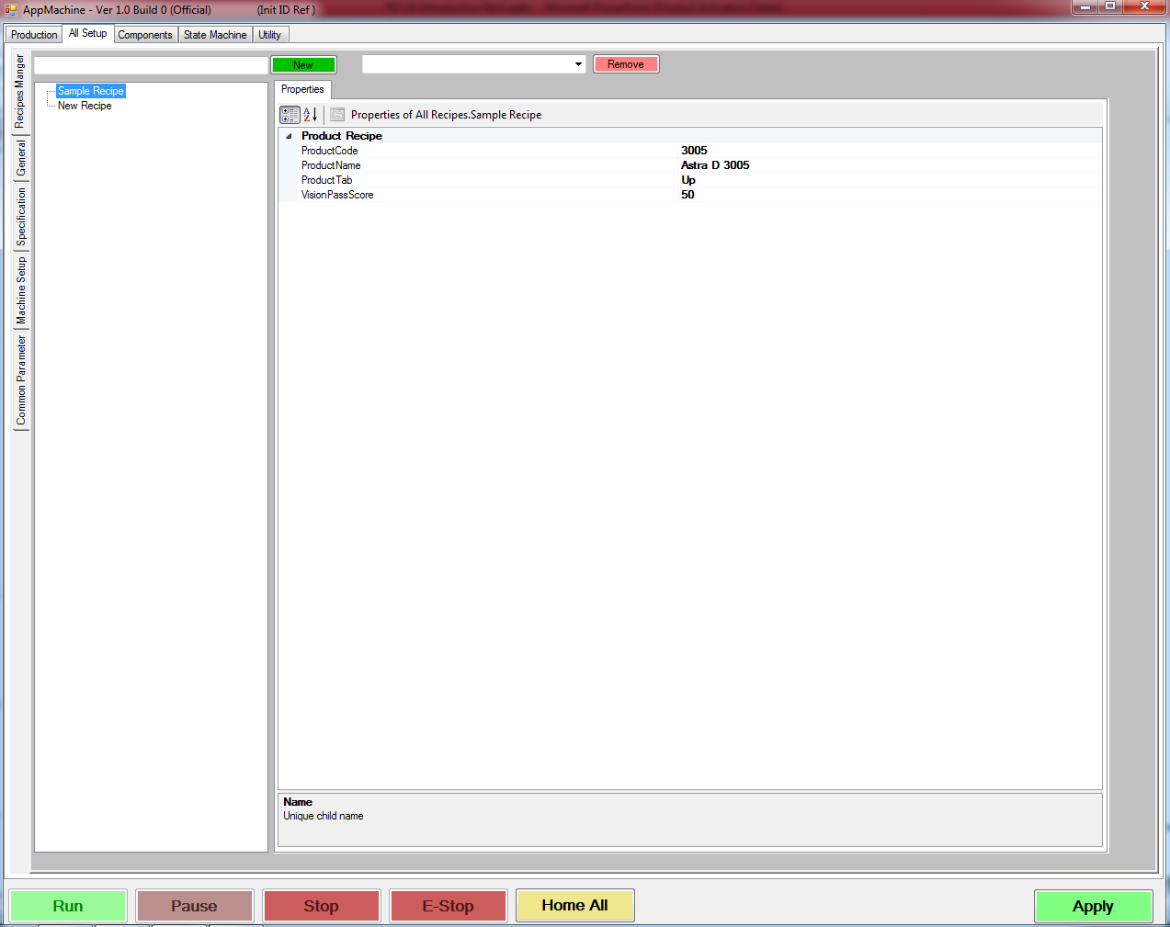
PDLib Application Layer GUI Pattern (Cont.)
All Setup & Recipes Manager Panel
All Setup Panel
Recipes
Manager
Panel
Machine setup panel
provided standard
sub-panel
Provided Recipes Manager Panel
with complete design and mechanism Code
to manage product recipes

Slide 10
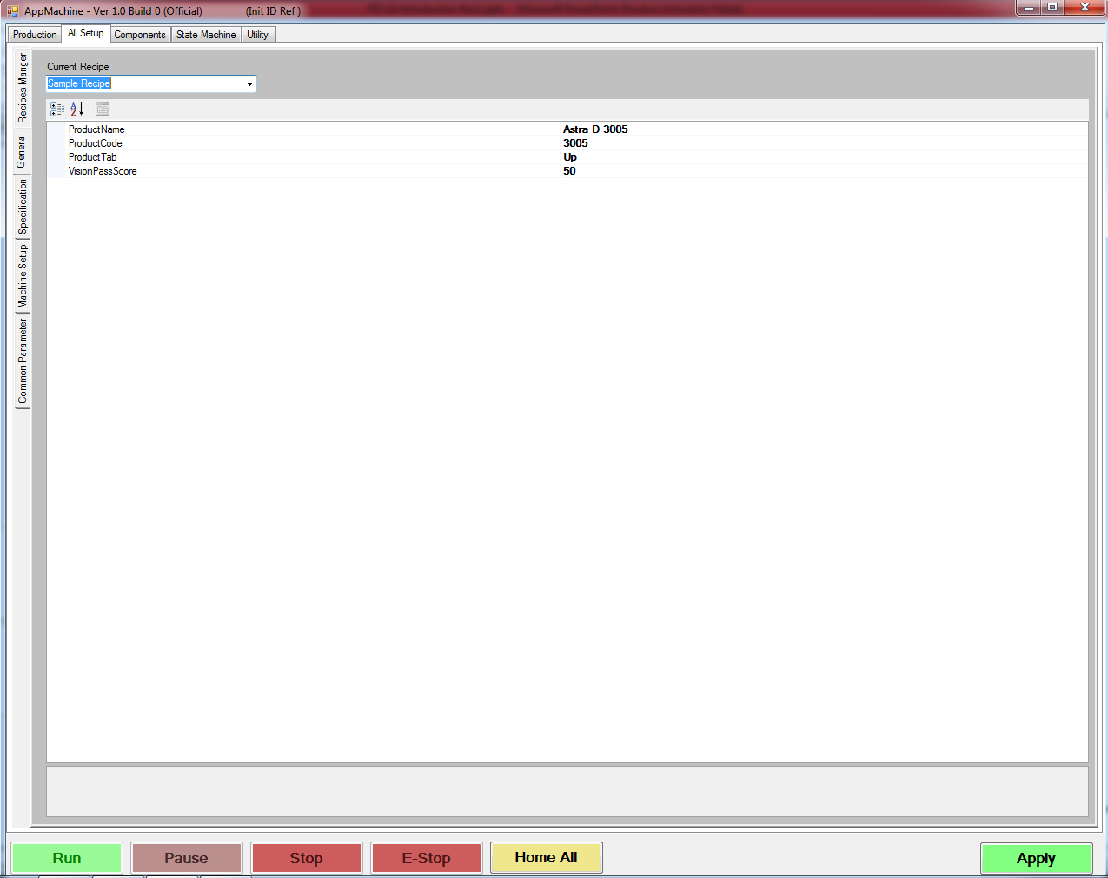
PDLib Application Layer GUI Pattern (Cont.)
General Panel
All Setup Panel
General
Setup Panel
Provided General Setup Panel
with complete design and mechanism code
to setup current product recipes

Slide 11
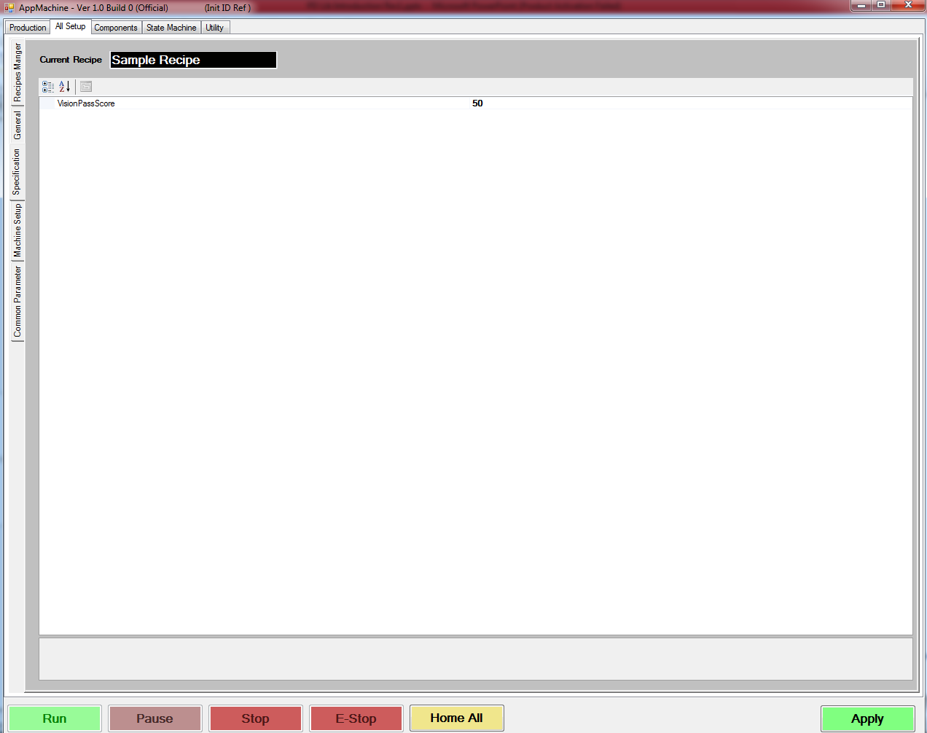
PDLib Application Layer GUI Pattern (Cont.)
Specification Panel
All Setup Panel
Specification
Panel
Provided Specification Panel
with complete design and mechanism code
to manage current product recipes specification

Slide 12
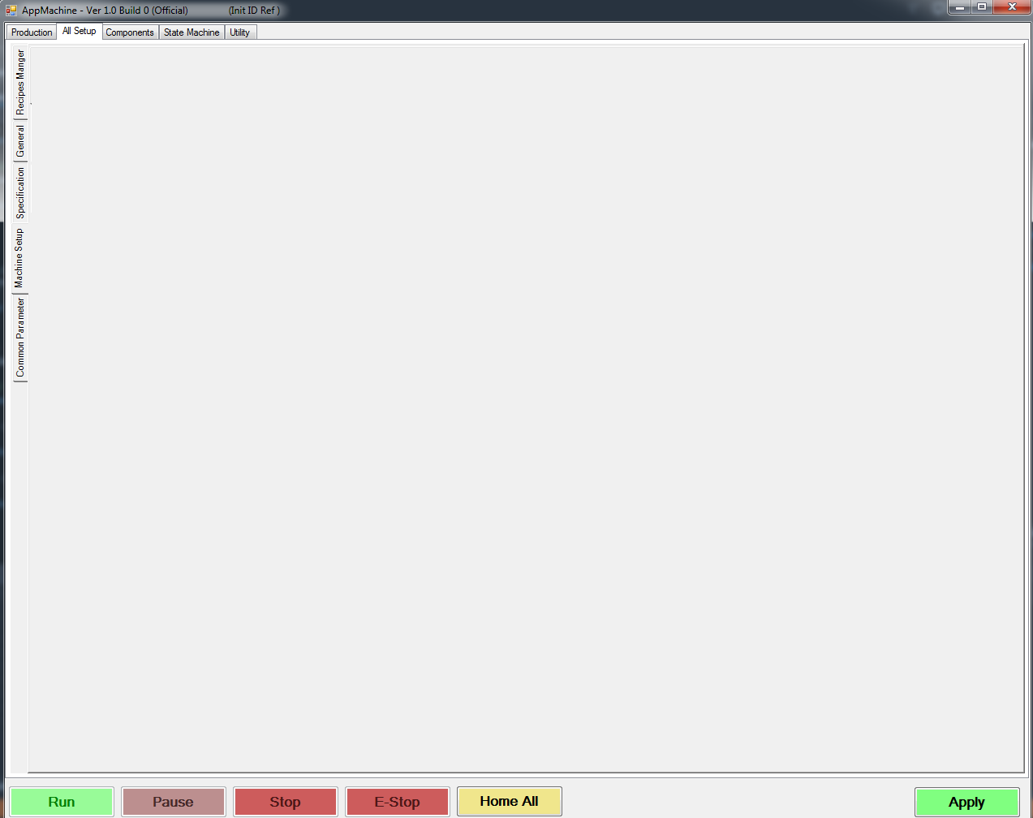
PDLib Application Layer GUI Pattern (Cont.)
Machine Setup Panel
All Setup Panel
Machine Setup
Panel
Machine Setup Panel free area to design
base on application requirement

Slide 13
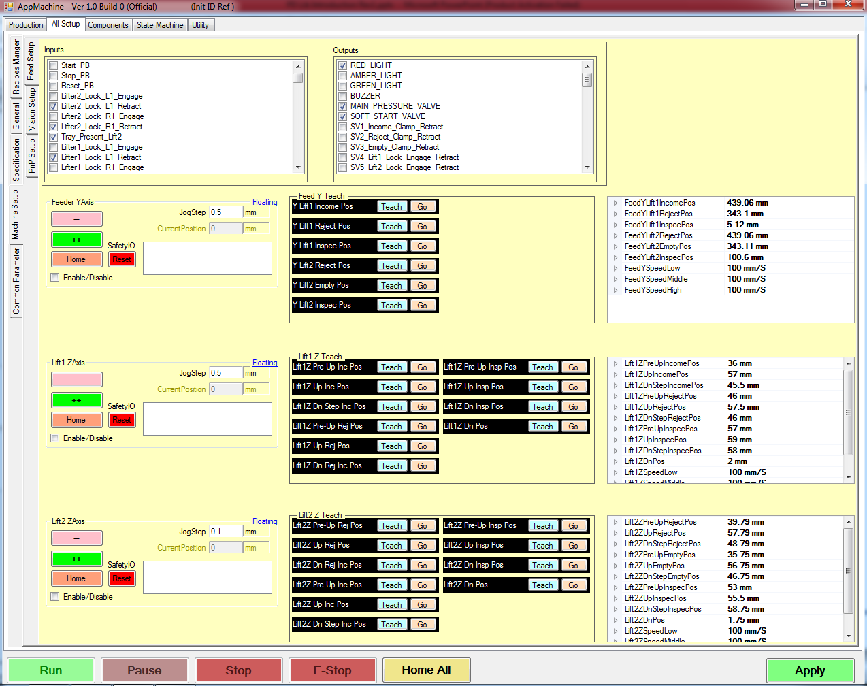
PDLib Application Layer GUI Pattern (Cont.)
Machine Setup Panel
All Setup Panel
Feed Setup
Panel
Machine Setup
Panel
Example sub-panel for
machine setup.
This example is motion setup
complete design on
HTO-Welder
Auto Loader Machine

Slide 14
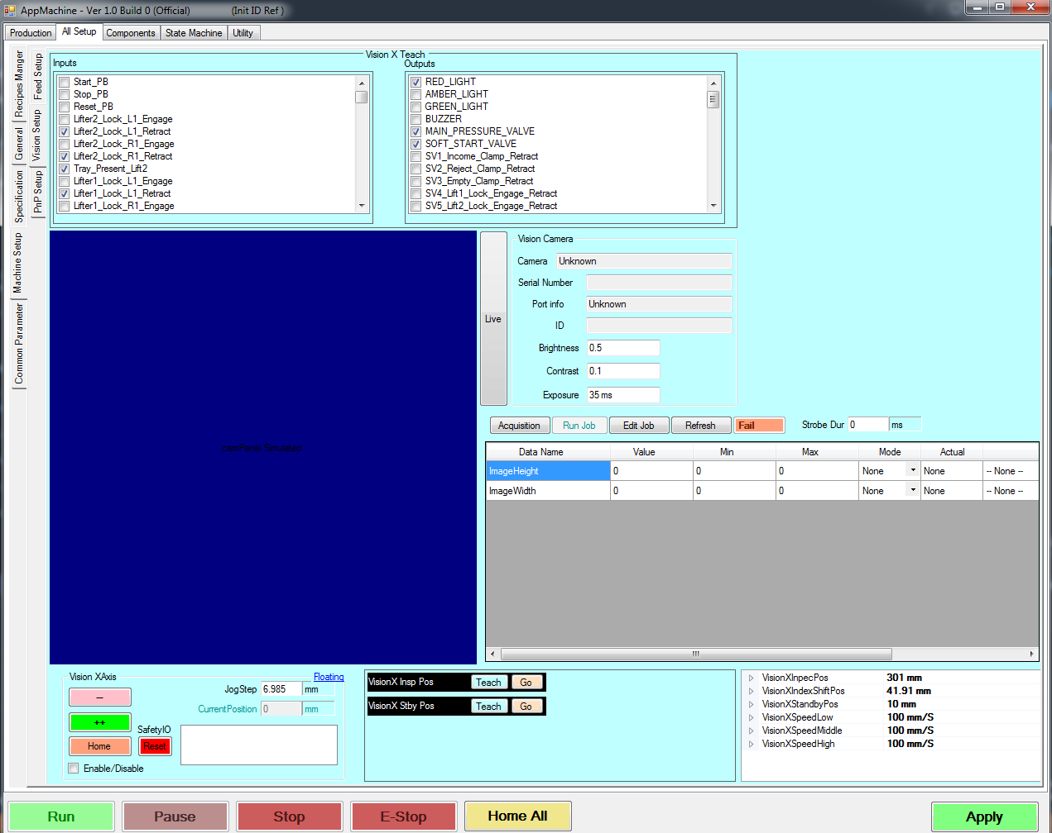
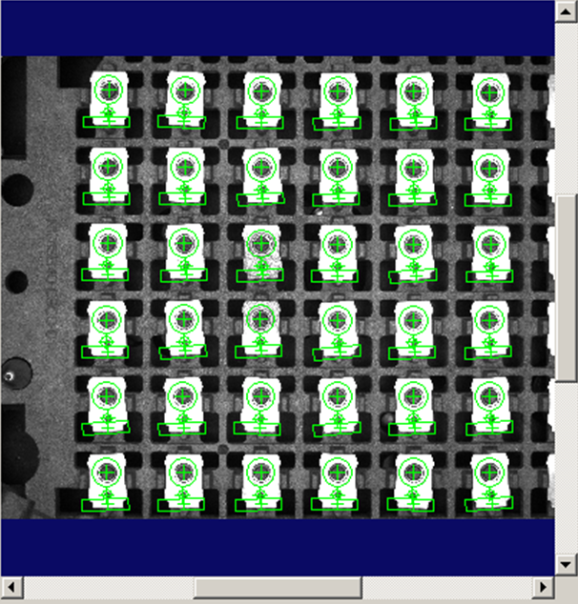
PDLib Application Layer GUI Pattern (Cont.)
Machine Setup Panel
All Setup Panel
Vision Setup
Panel
Machine Setup
Panel
Example sub-panel for
machine setup.
This Example is vision Setup
Complete Design on
HTO-Welder
Auto Loader Machine

Slide 15
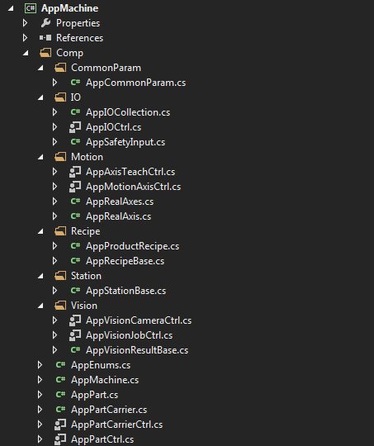
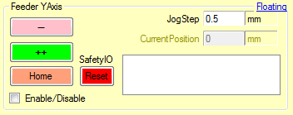

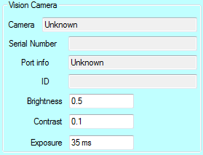
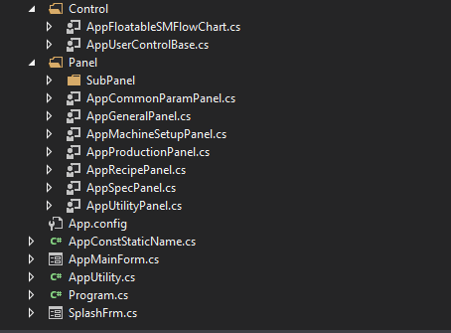
PDLib Application Layer GUI Pattern (Cont.)
Example Provide GUI Control for Machine Application
Motion teach position control
This control can support any motion axis. It allow you to teach current position of motion axis and save to target property with “Teach” button . It also allow you to command motion to go to memory position by “Go” button. This control can re-use for support a
any teach position.
Motion axis control
This control can support any motion axis. It allow you to teach home, enable/disable, reset and jog positive and negative direction
With adjustable jog distance per step.
This control can re-use for support for control any motion axis.
Vision camera control
This control can support any vision camera.
It allow you to adjust basic camera parameter like
brightness, contrast and exposure. You can trigger camera
to continuous capture and display image by “Live” button
This control can re-use for support for control any vision camera.

Slide 16
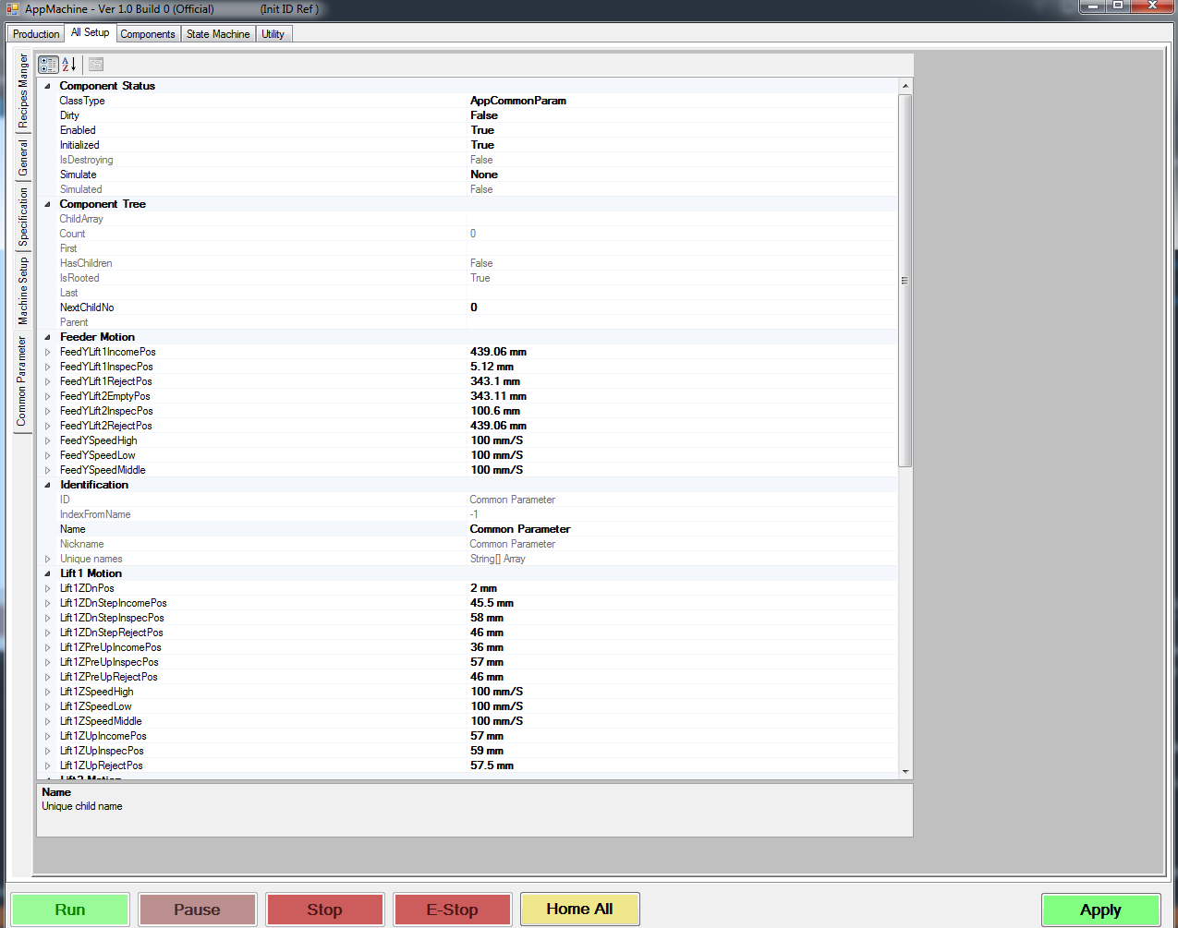
PDLib Application Layer GUI Pattern (Cont.)
All Setup Panel
Provided Common Parameter Panel
with complete design and mechanism Code
to manage common parameter
Common Parameter
Panel

Slide 17
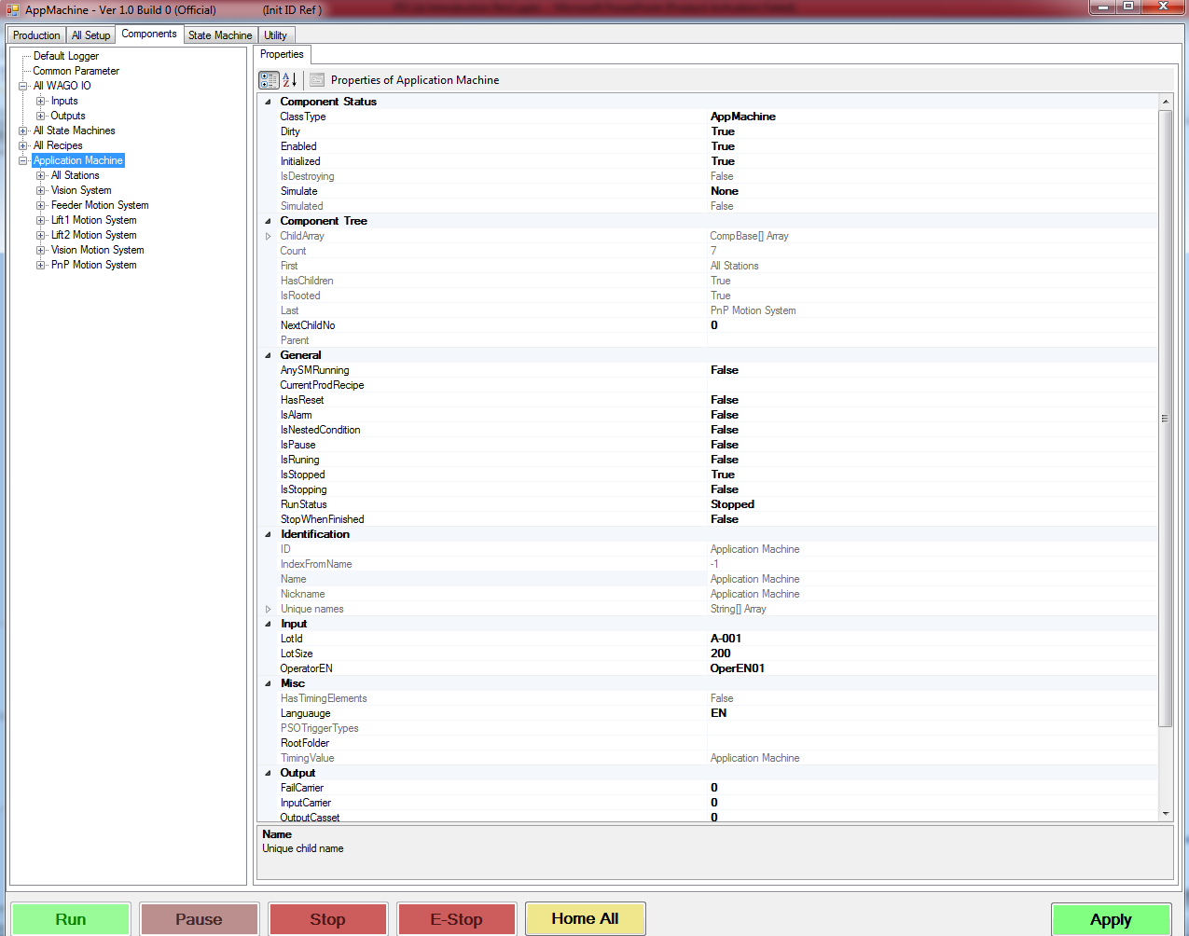
PDLib Application Layer GUI Pattern (Cont.)
Component Panel
Provided Component Panel
with complete design and mechanism code
to browse any component and view its
additional specific panel
include mechanism to mange component property.

Slide 18
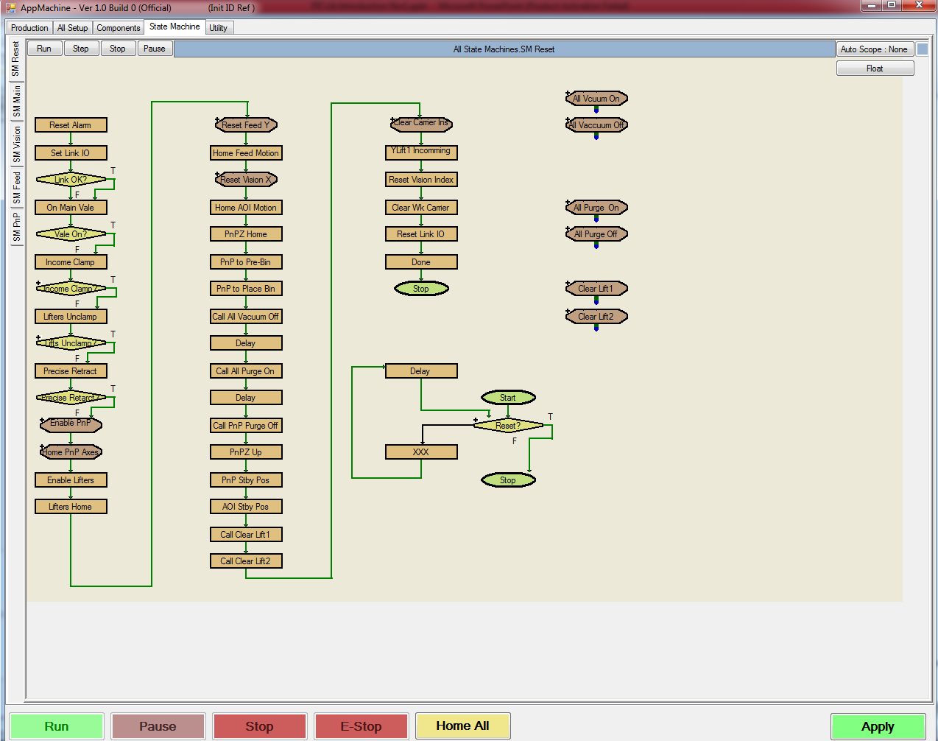
PDLib Application Layer GUI Pattern (Cont.)
State Machine Panel
Provided State Machine Panel
with complete design and mechanism code
to create and edit each state machine.

Slide 19
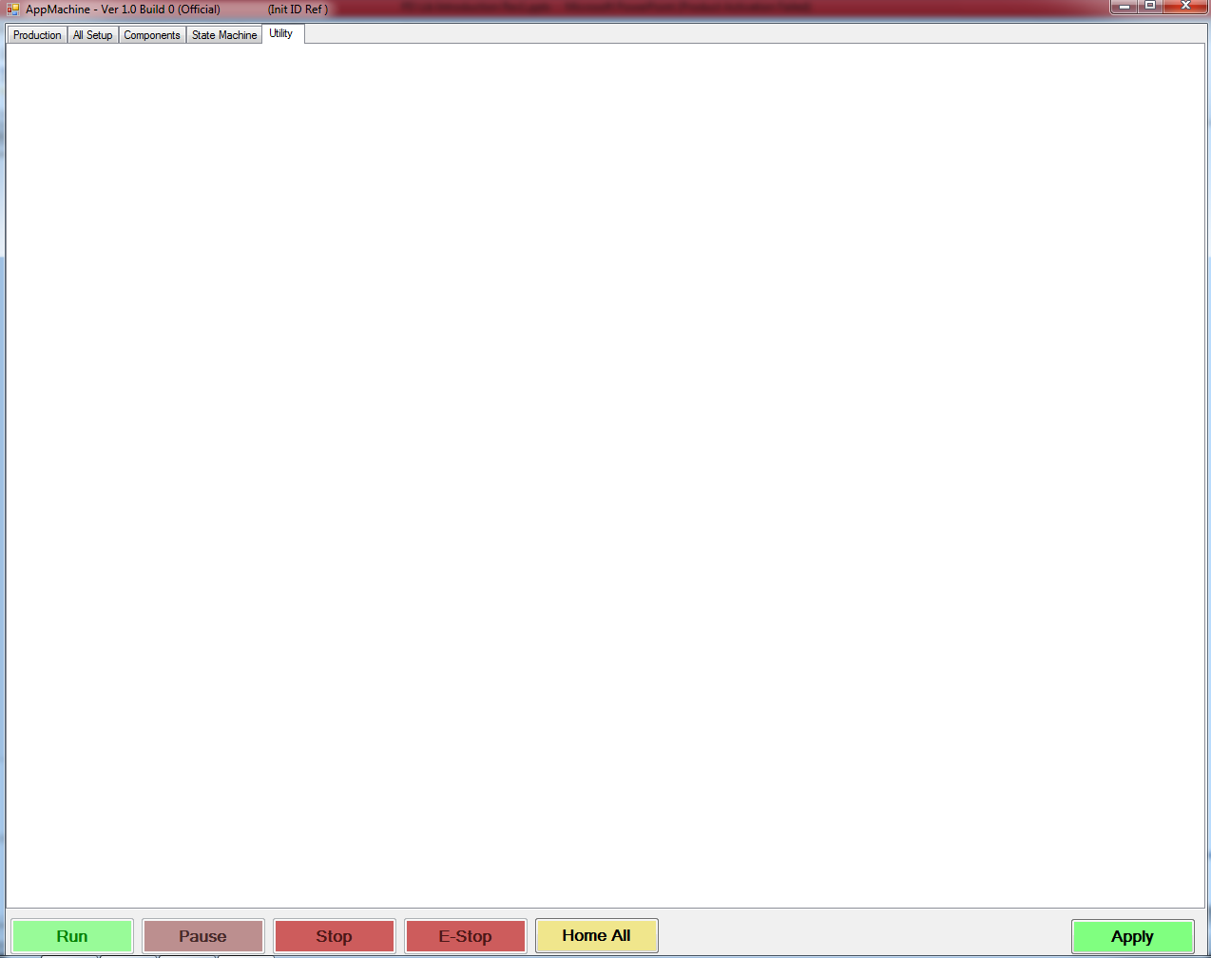
PDLib Application Layer GUI Pattern (Cont.)
Utility Panel free area to design
base on application requirement

Slide 20
Thank You

